Slide 1
Digital leaders Challenge 2 WEDNESDAYS WE PRACTICE WHAT WE ARE going to be DOING THAT WEEK.
What we have been up to this term

Slide 2
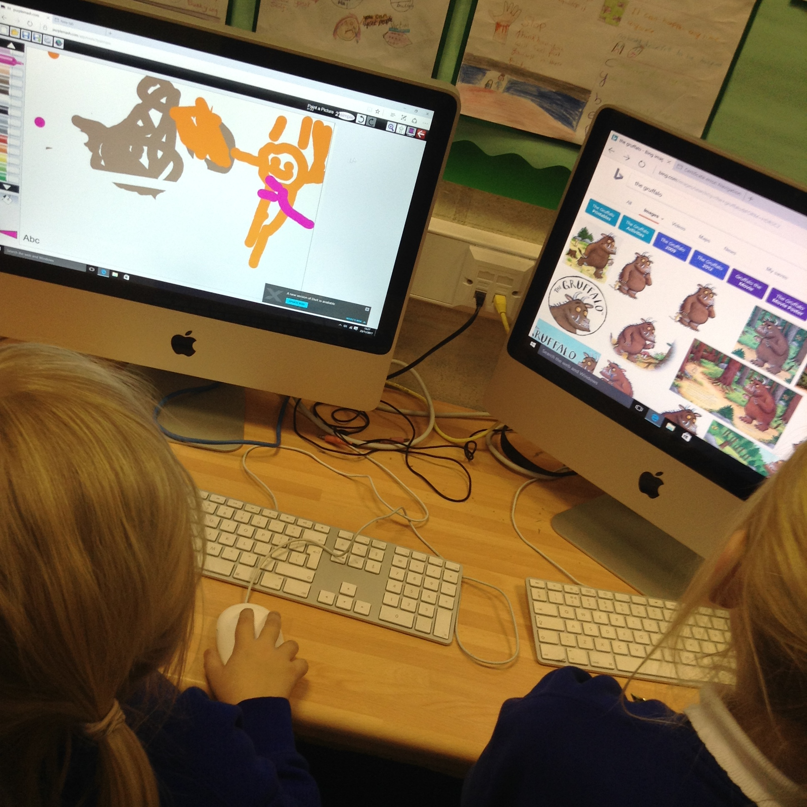
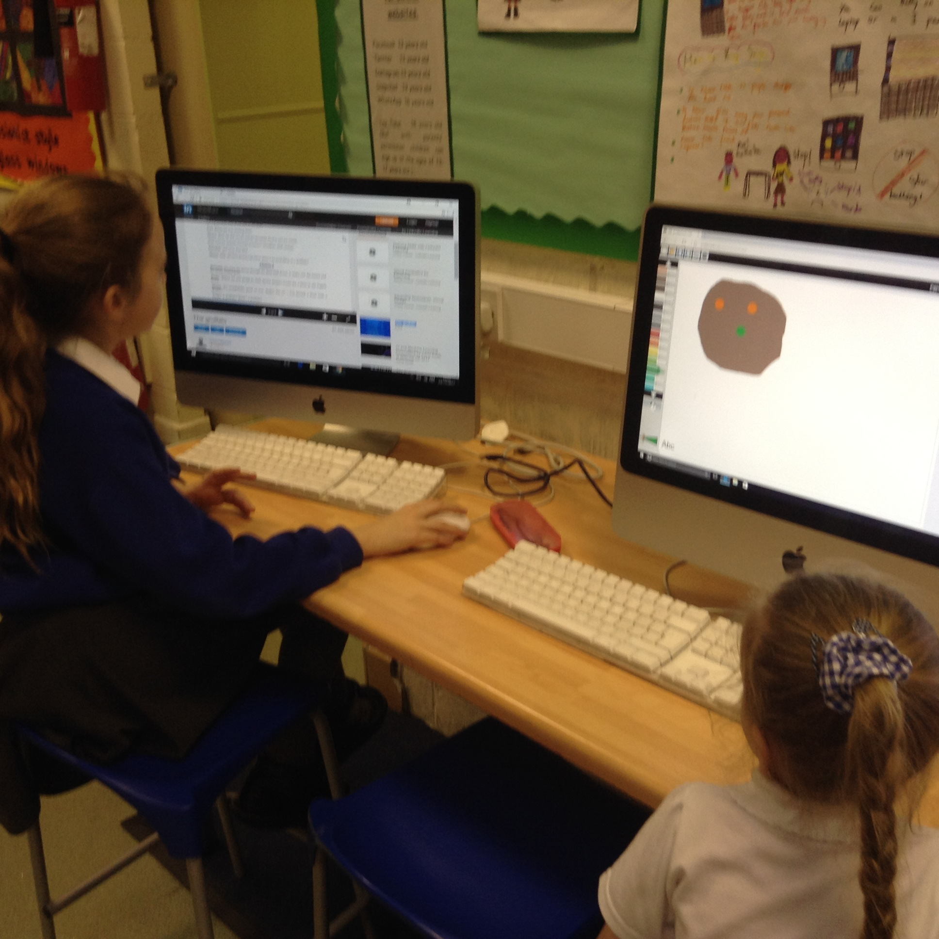
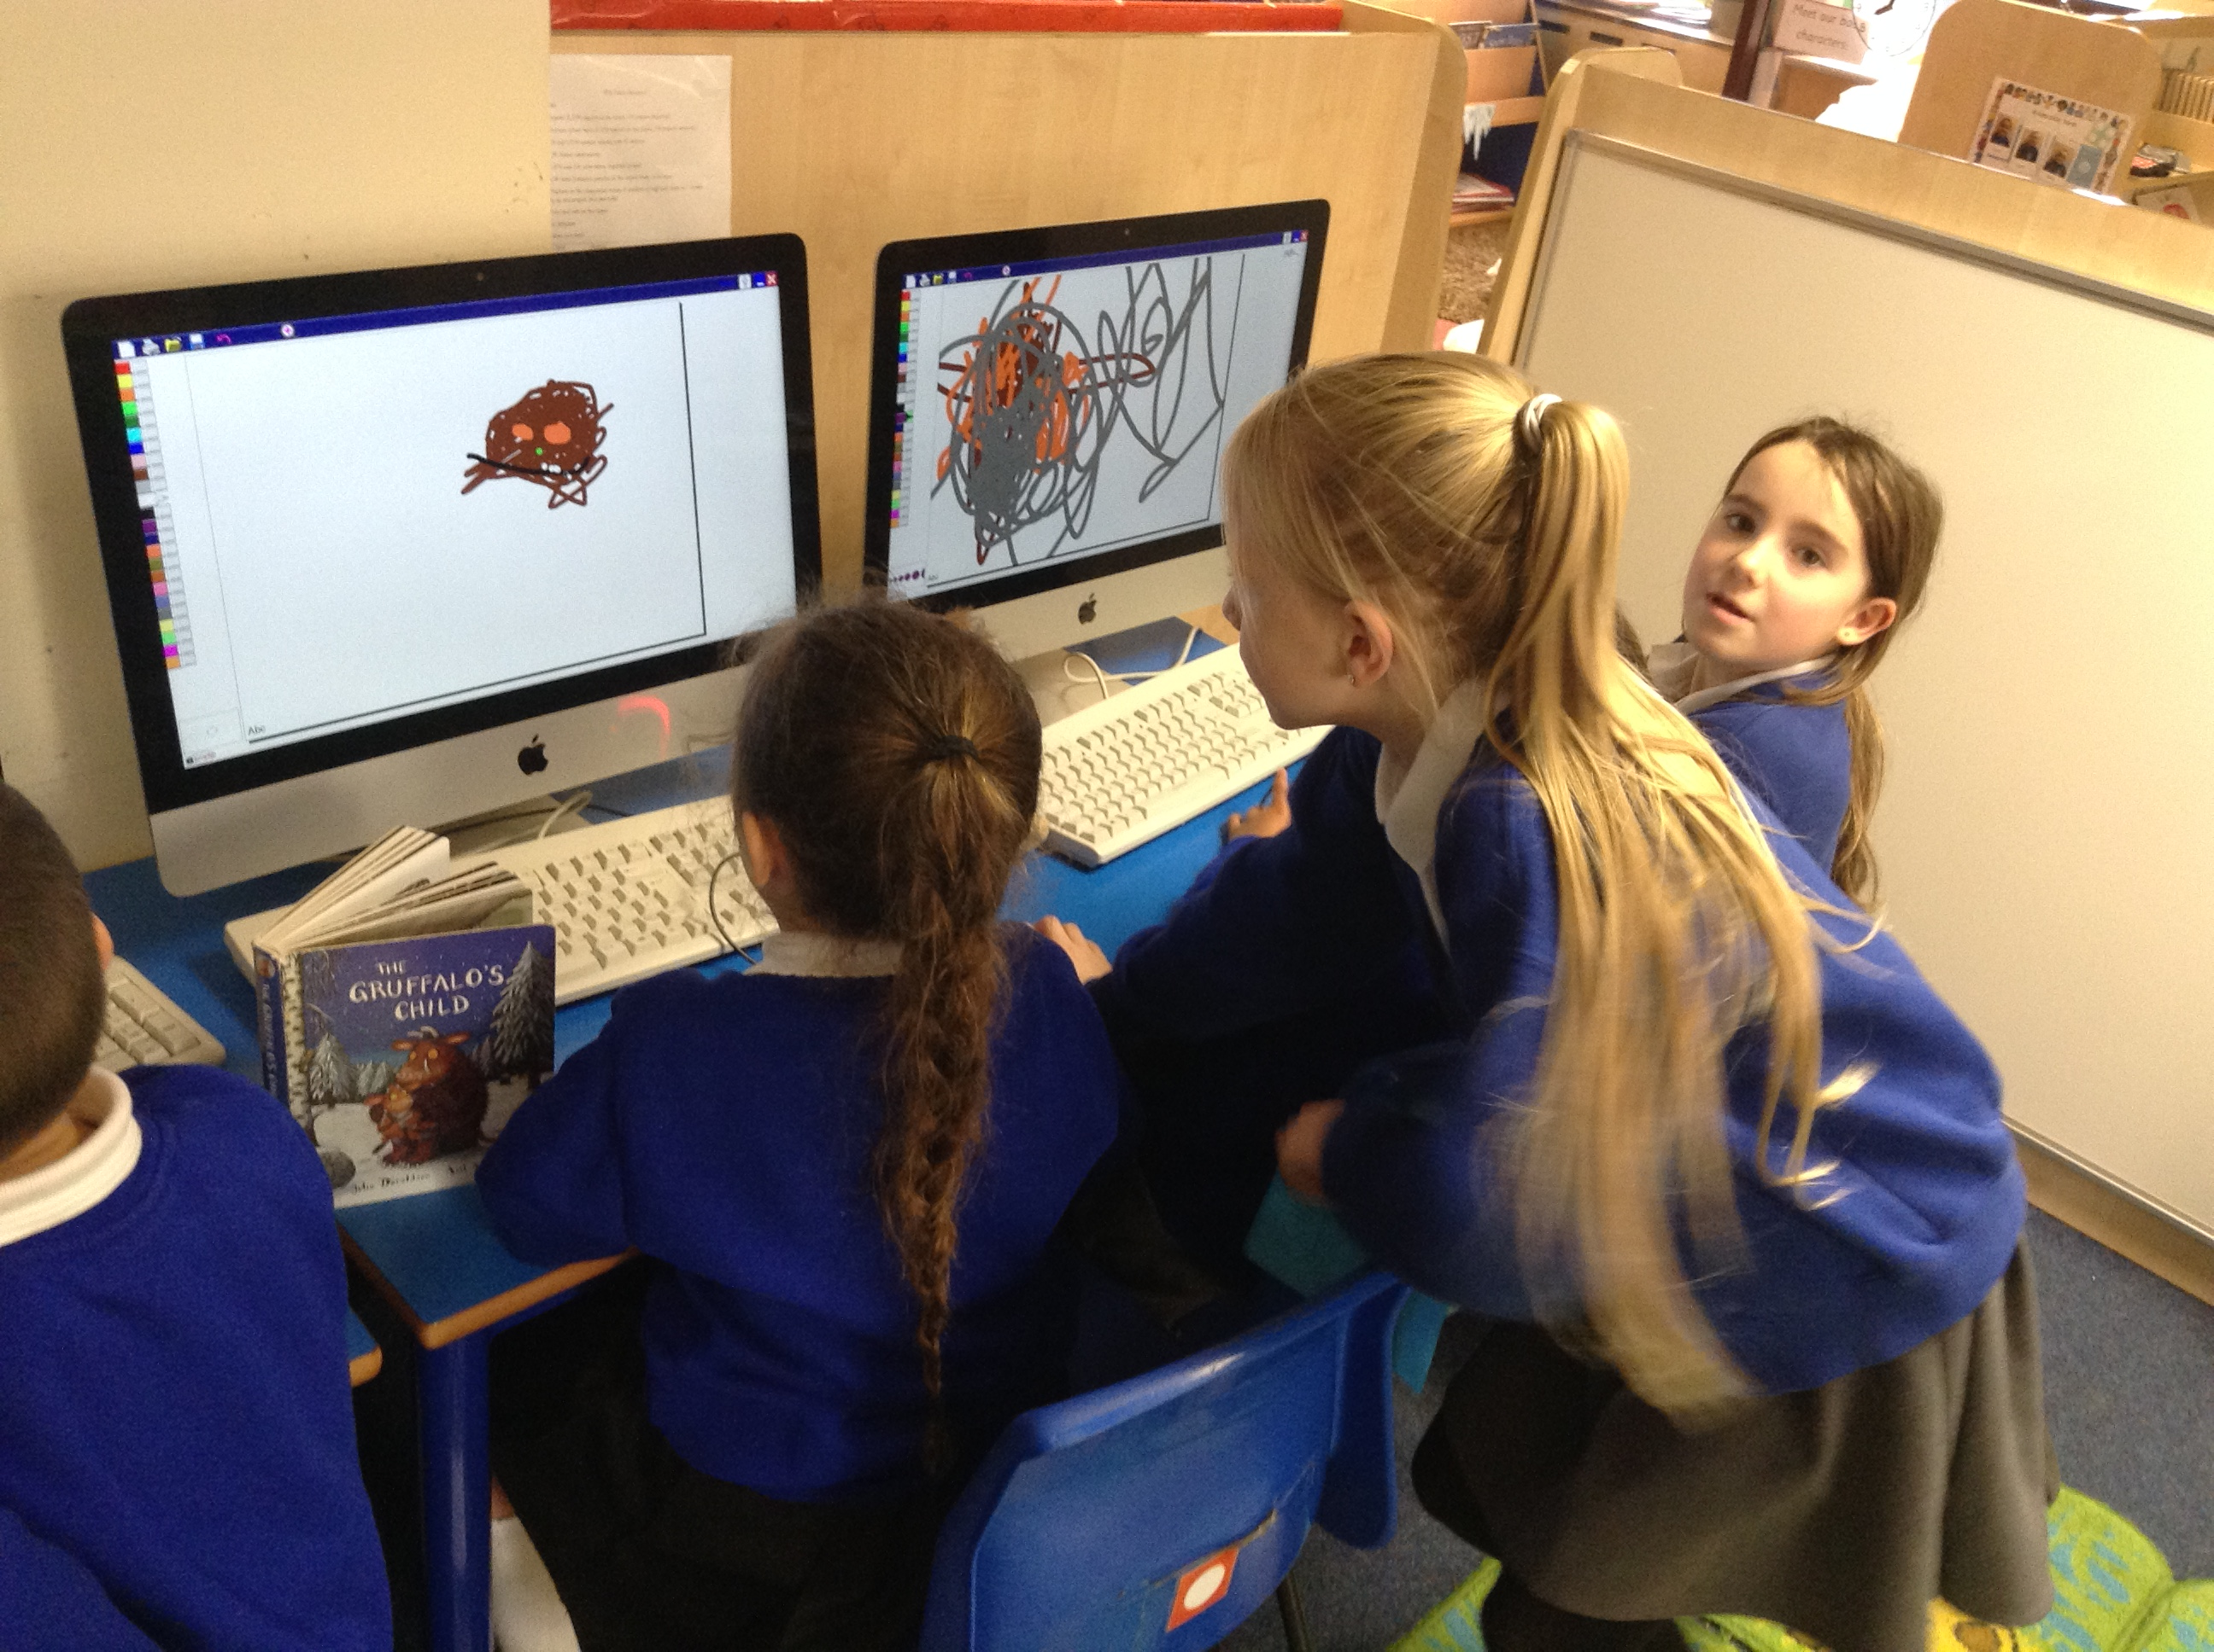
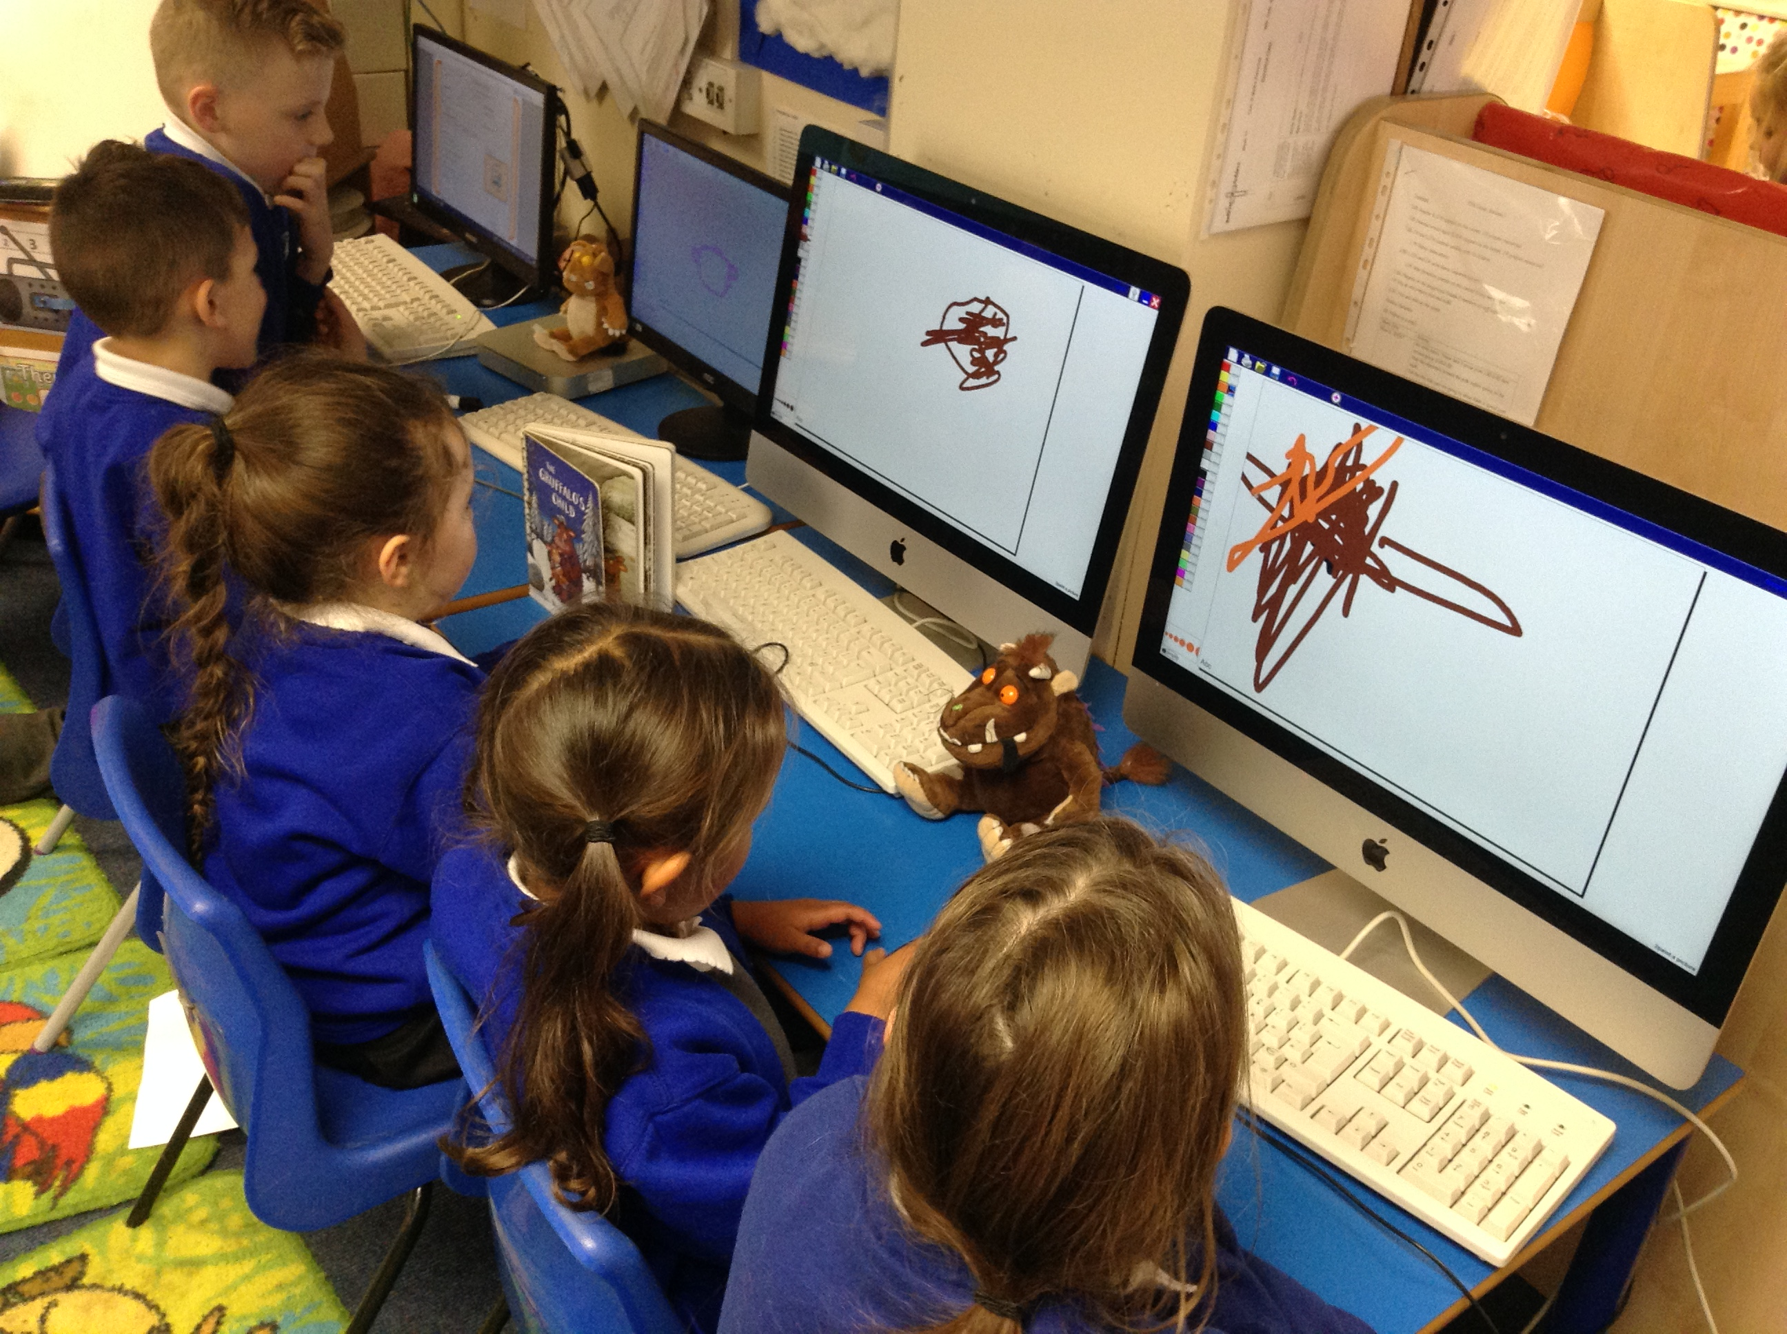
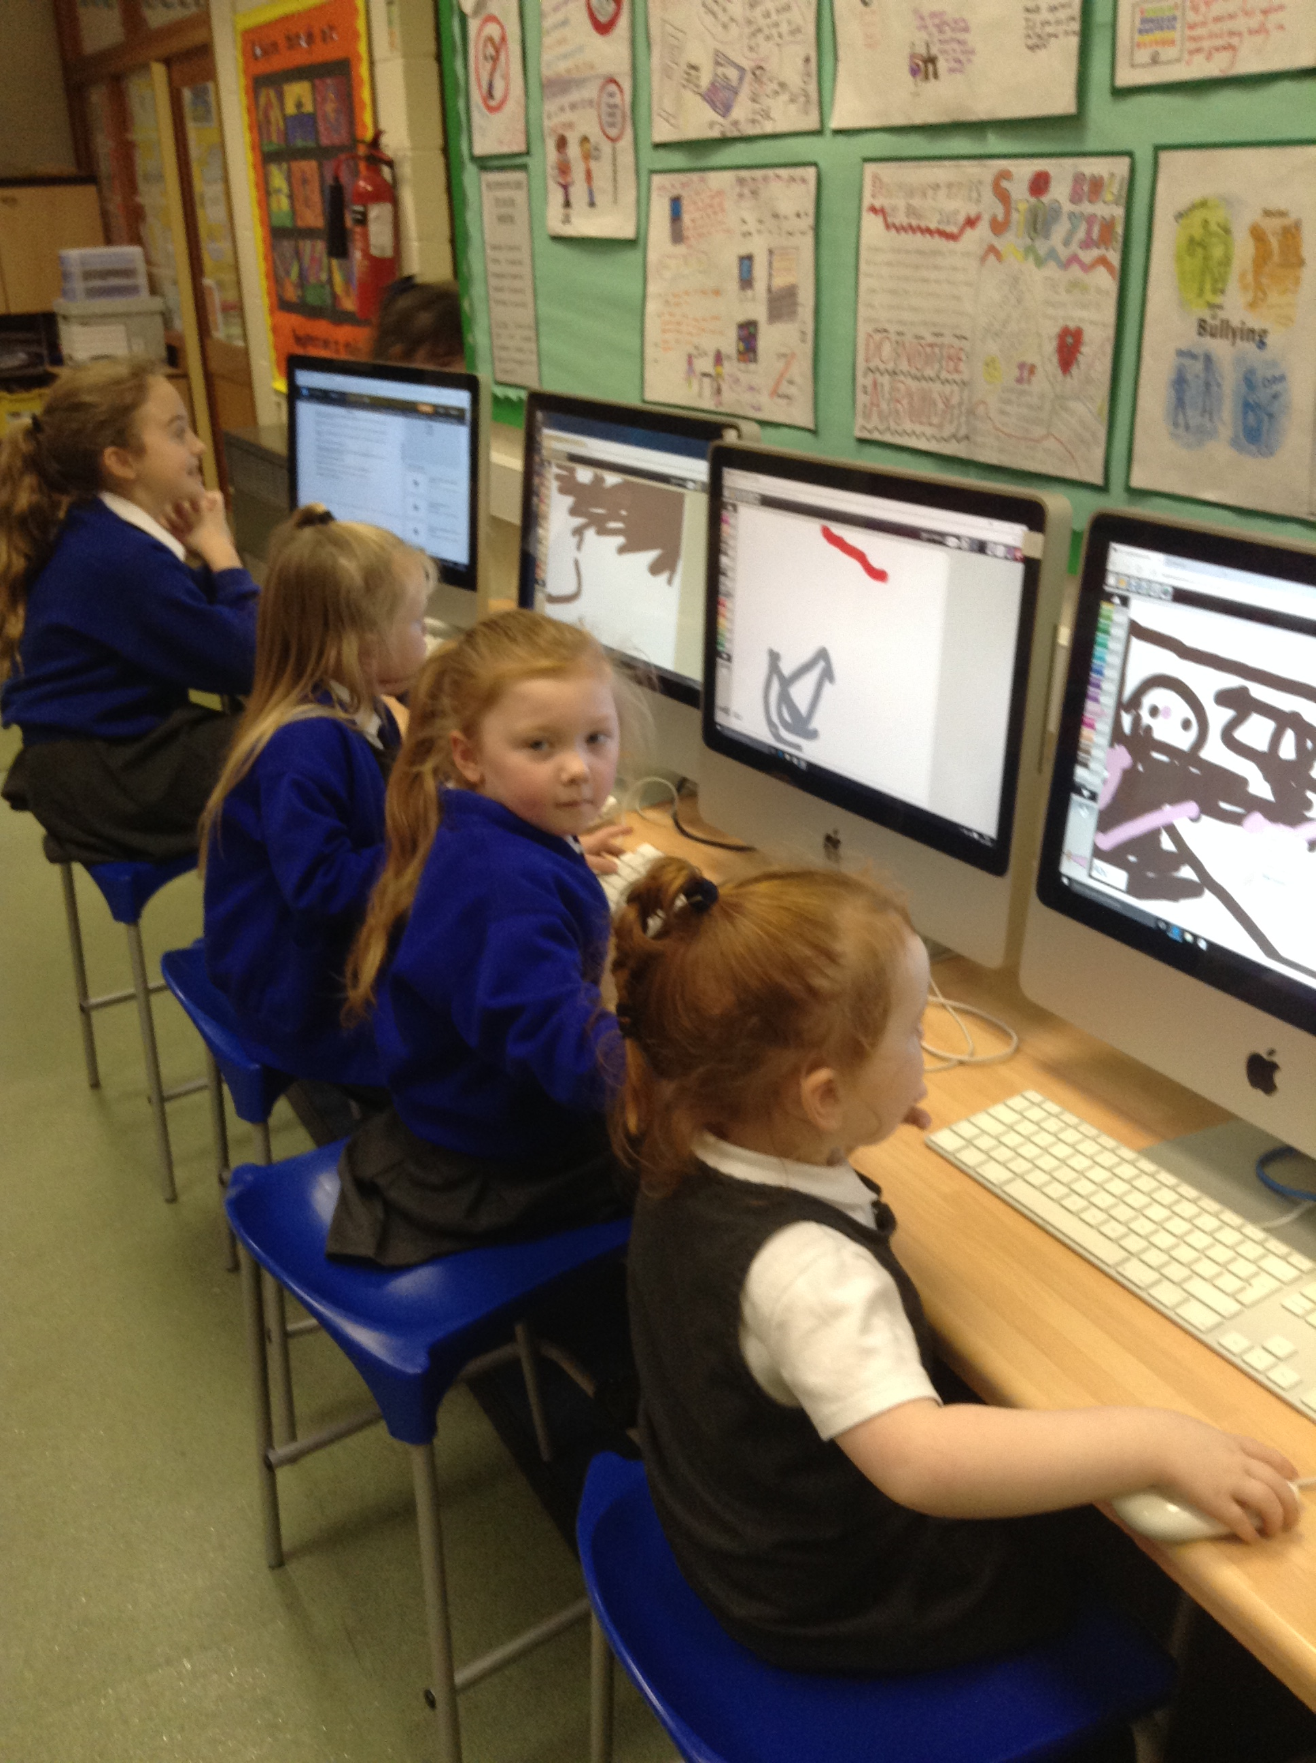
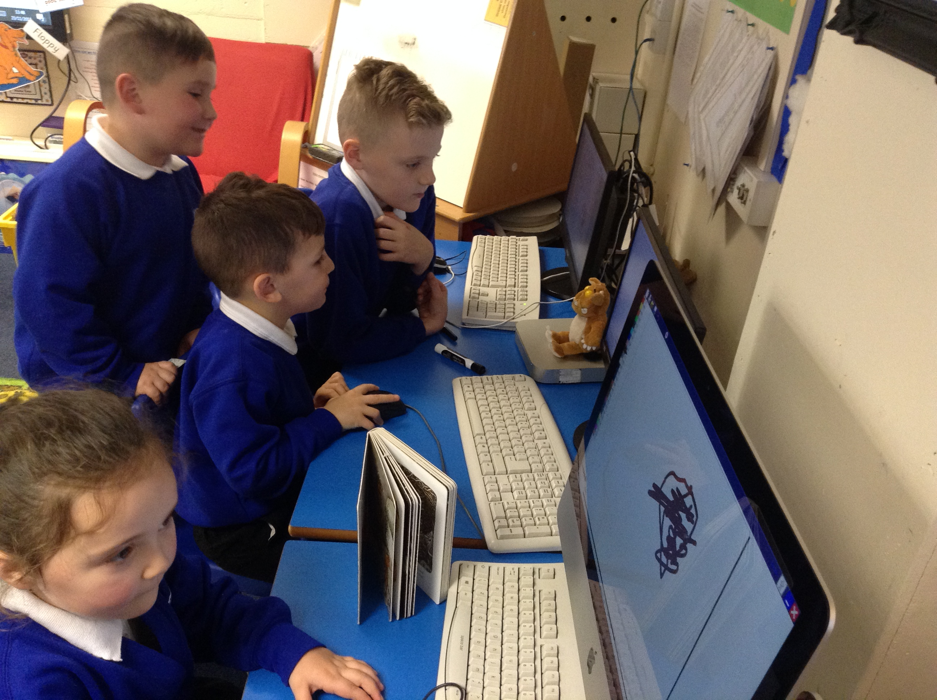
RECEPTION
RECEPTION WERE LOOKING AT THE GRUFFOLO IN THEIR LESSONS SO THEIR TEACHER KINDLY ASKED IF WE COULD HELP THEM DRAW GRUFFOLO PICTURES ON THEIR CLASS COMPUTERS
WE TOOK BUTTERCUPS INTO THE JUNIORS TO DO THEIRS WHILST LISTENING TO US READ THE STORY
AND BLUEBELLS DID THEM ON THEIR COMPUTERS WITH THE TEDDYS

Slide 3
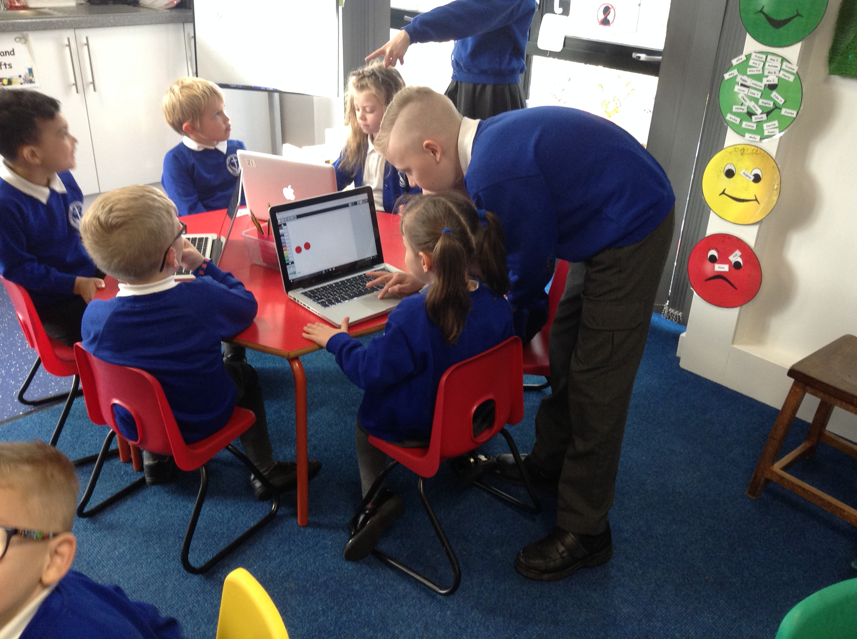
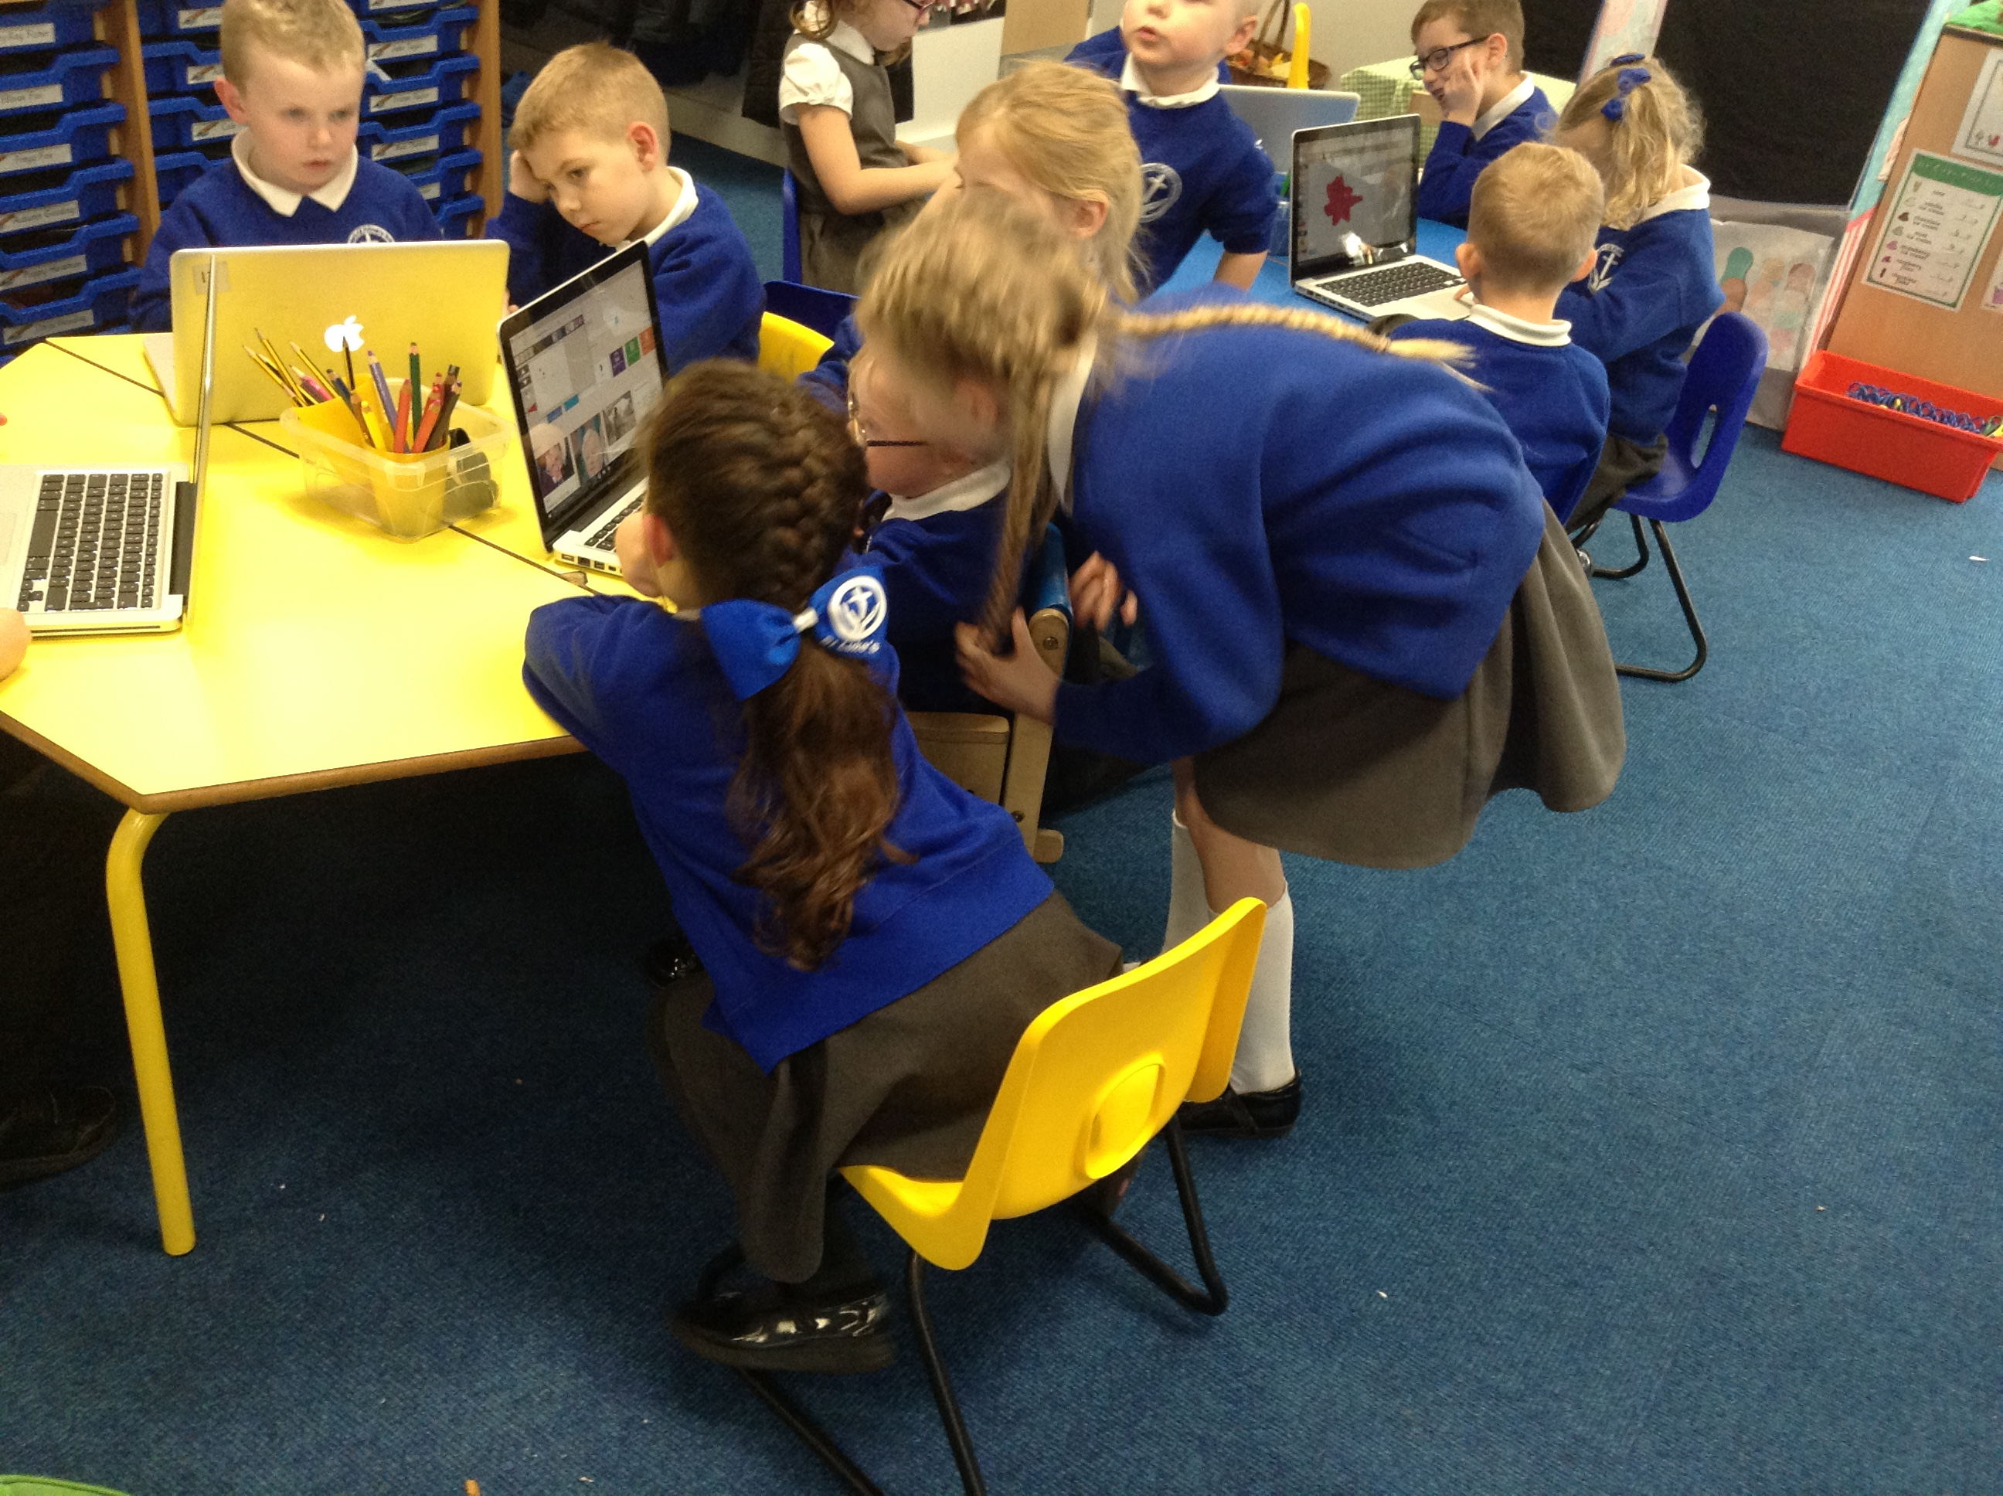
YEAR 1
YEAR 1 WERE LOOKING AT LEAF MAN SO THEY HAD TO DRAW PICTURES OF THE LEAF MAN ON THE SCHOOL LAPTOPS
THEY DID REALLY WELL AND CAME UP WITH SOME GOOD IDEAS

Slide 4
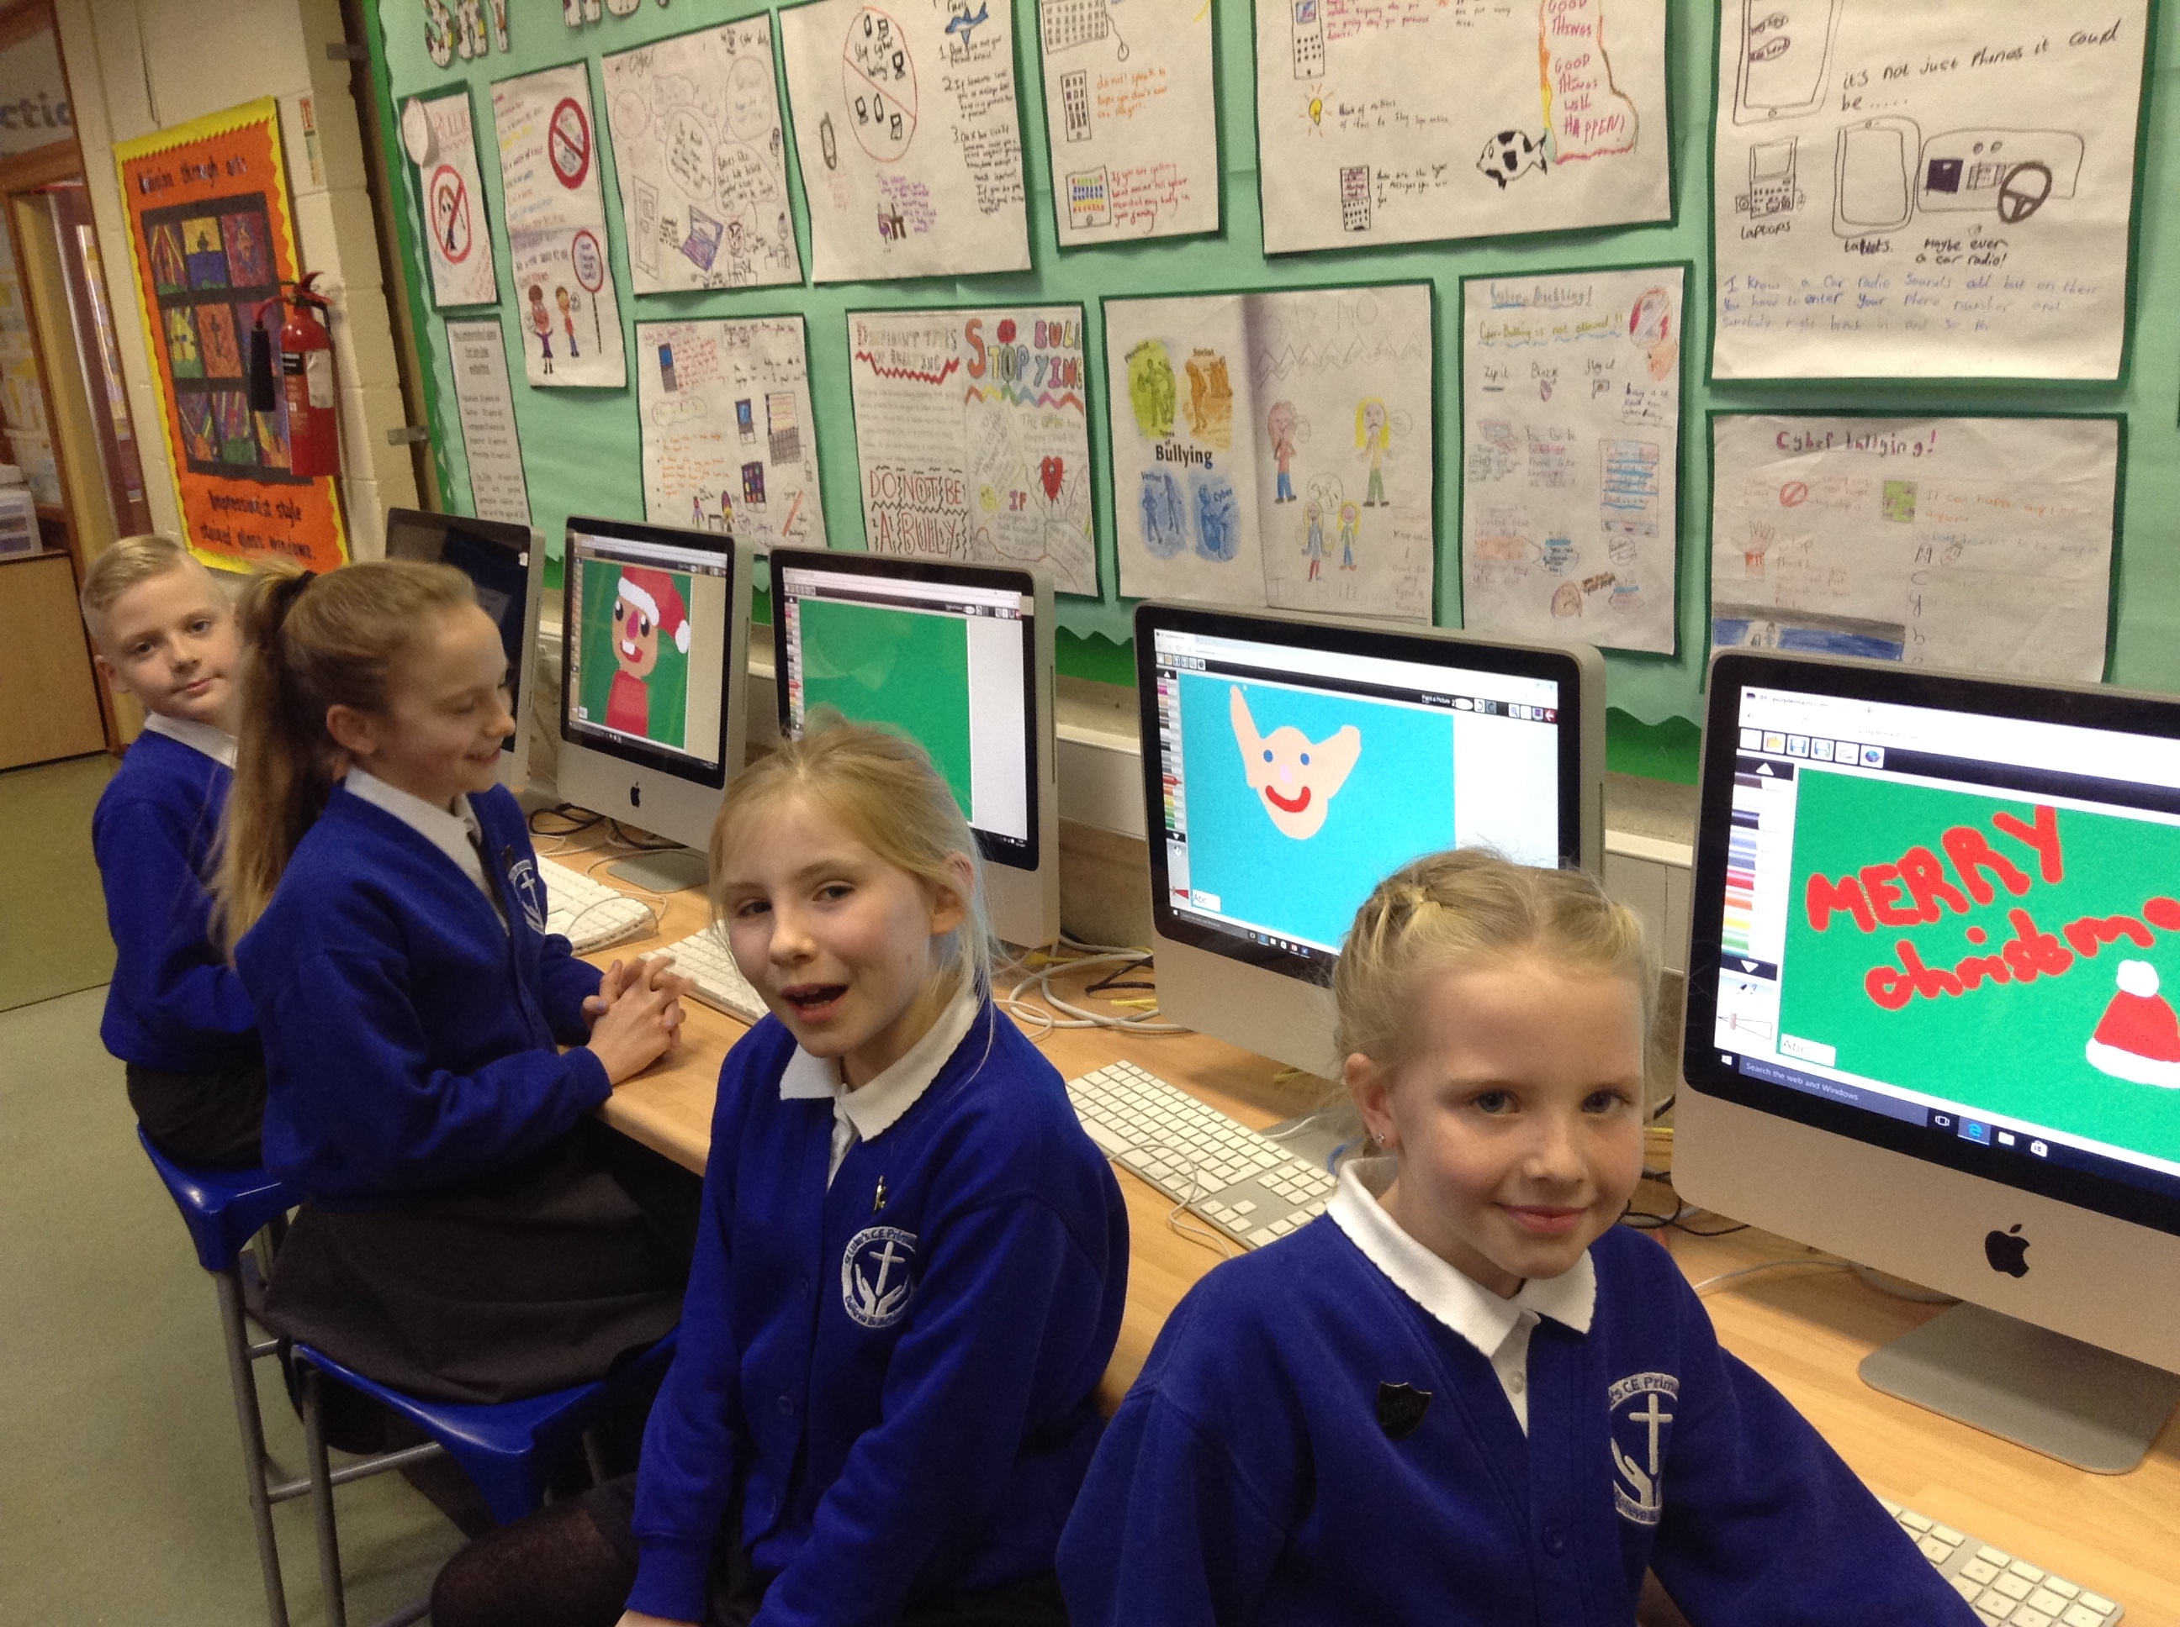
Year 2
Year 2 has been looking at drawing a Christmas card. We practiced doing one on Wednesdays so we can show them our art skills. we helped them make a good one and they did an excellent job.

Slide 5
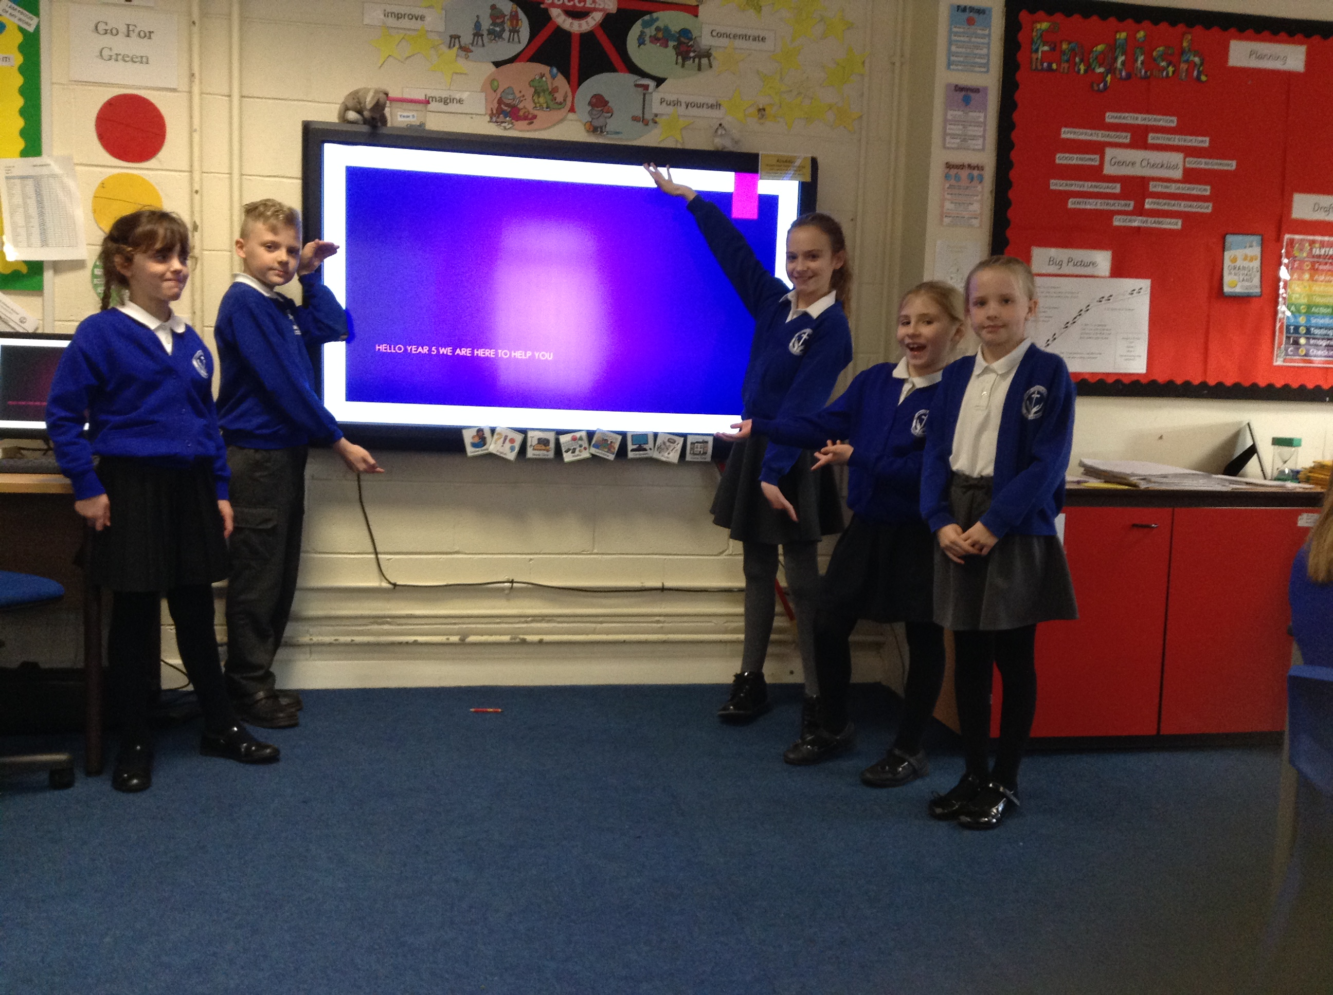
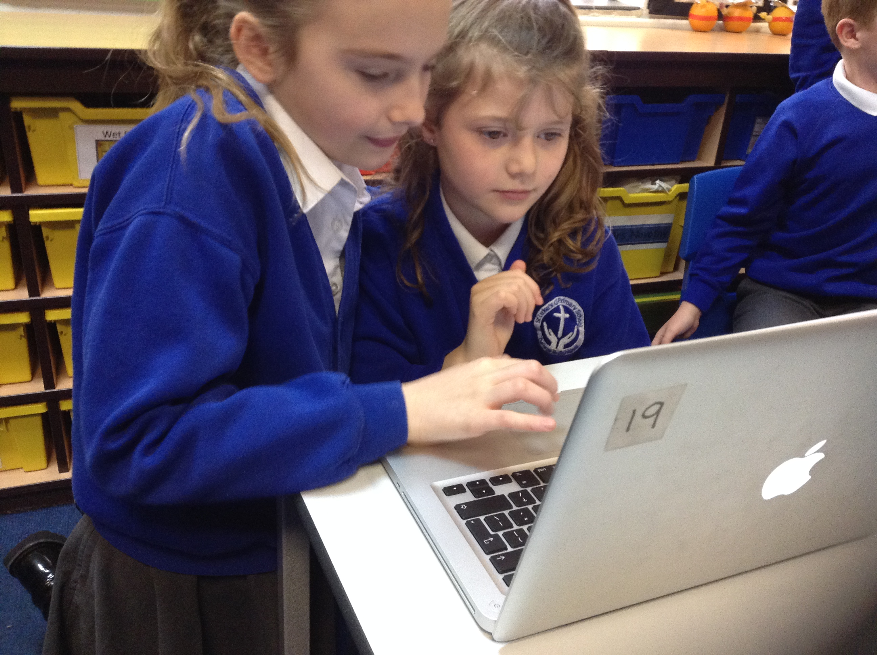
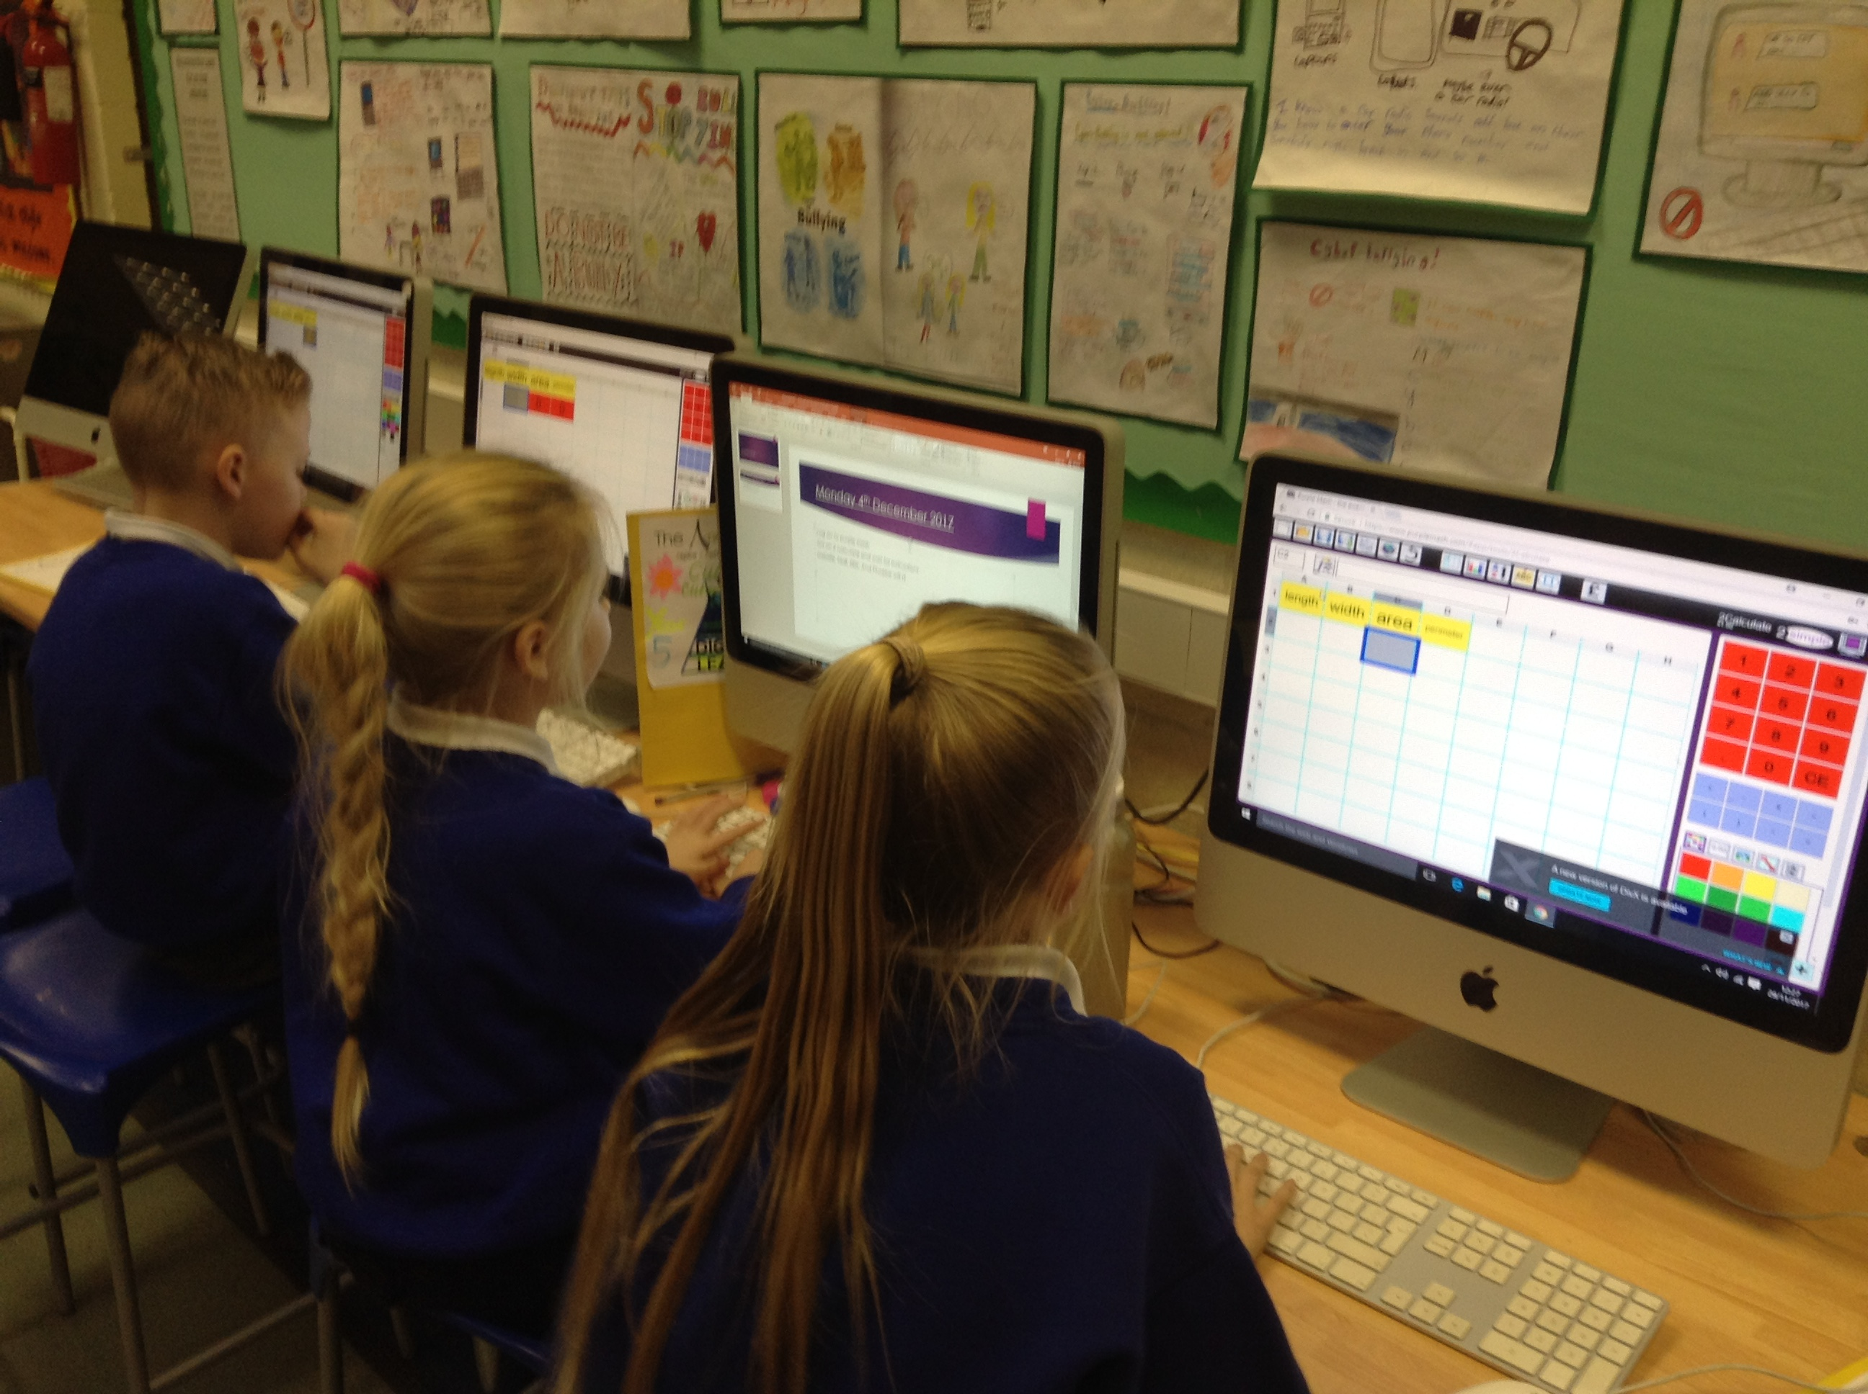
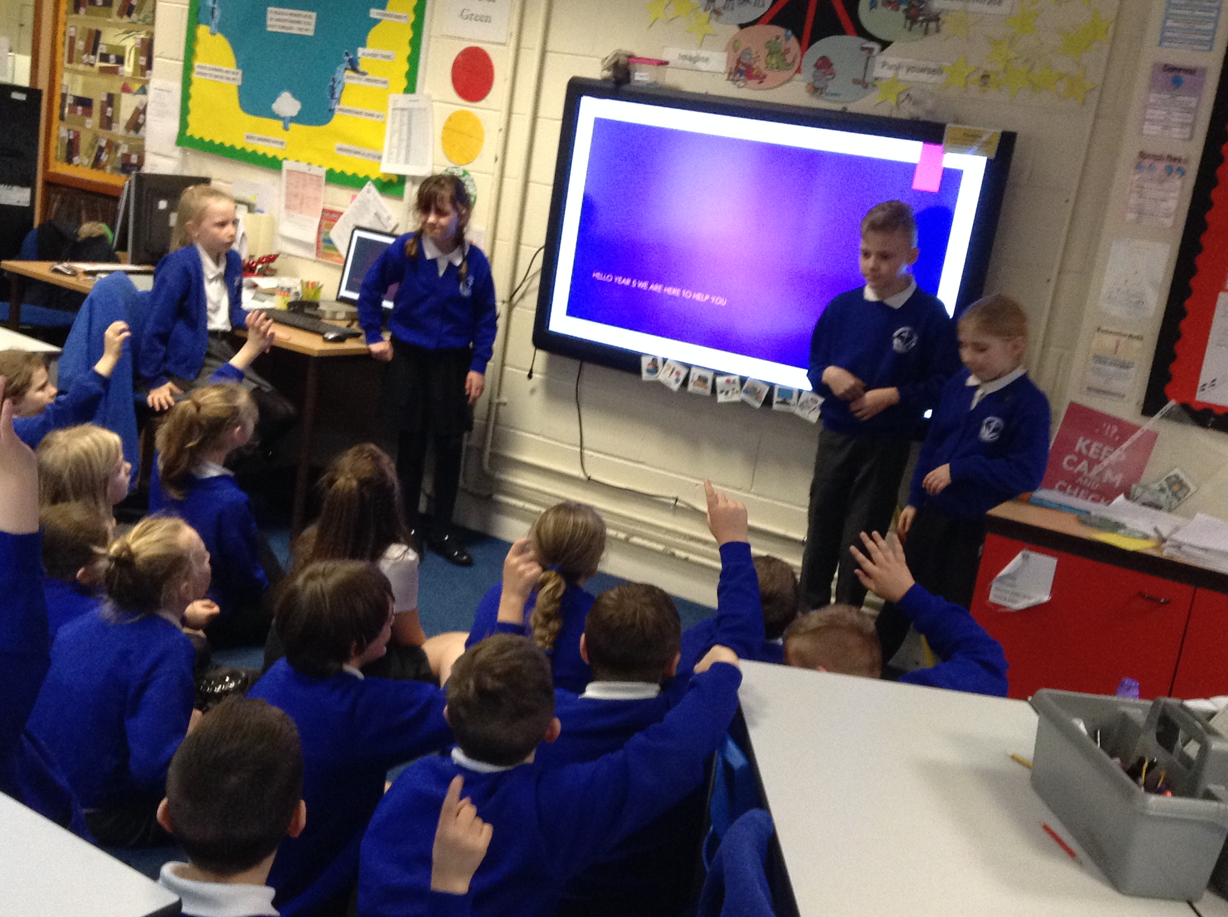
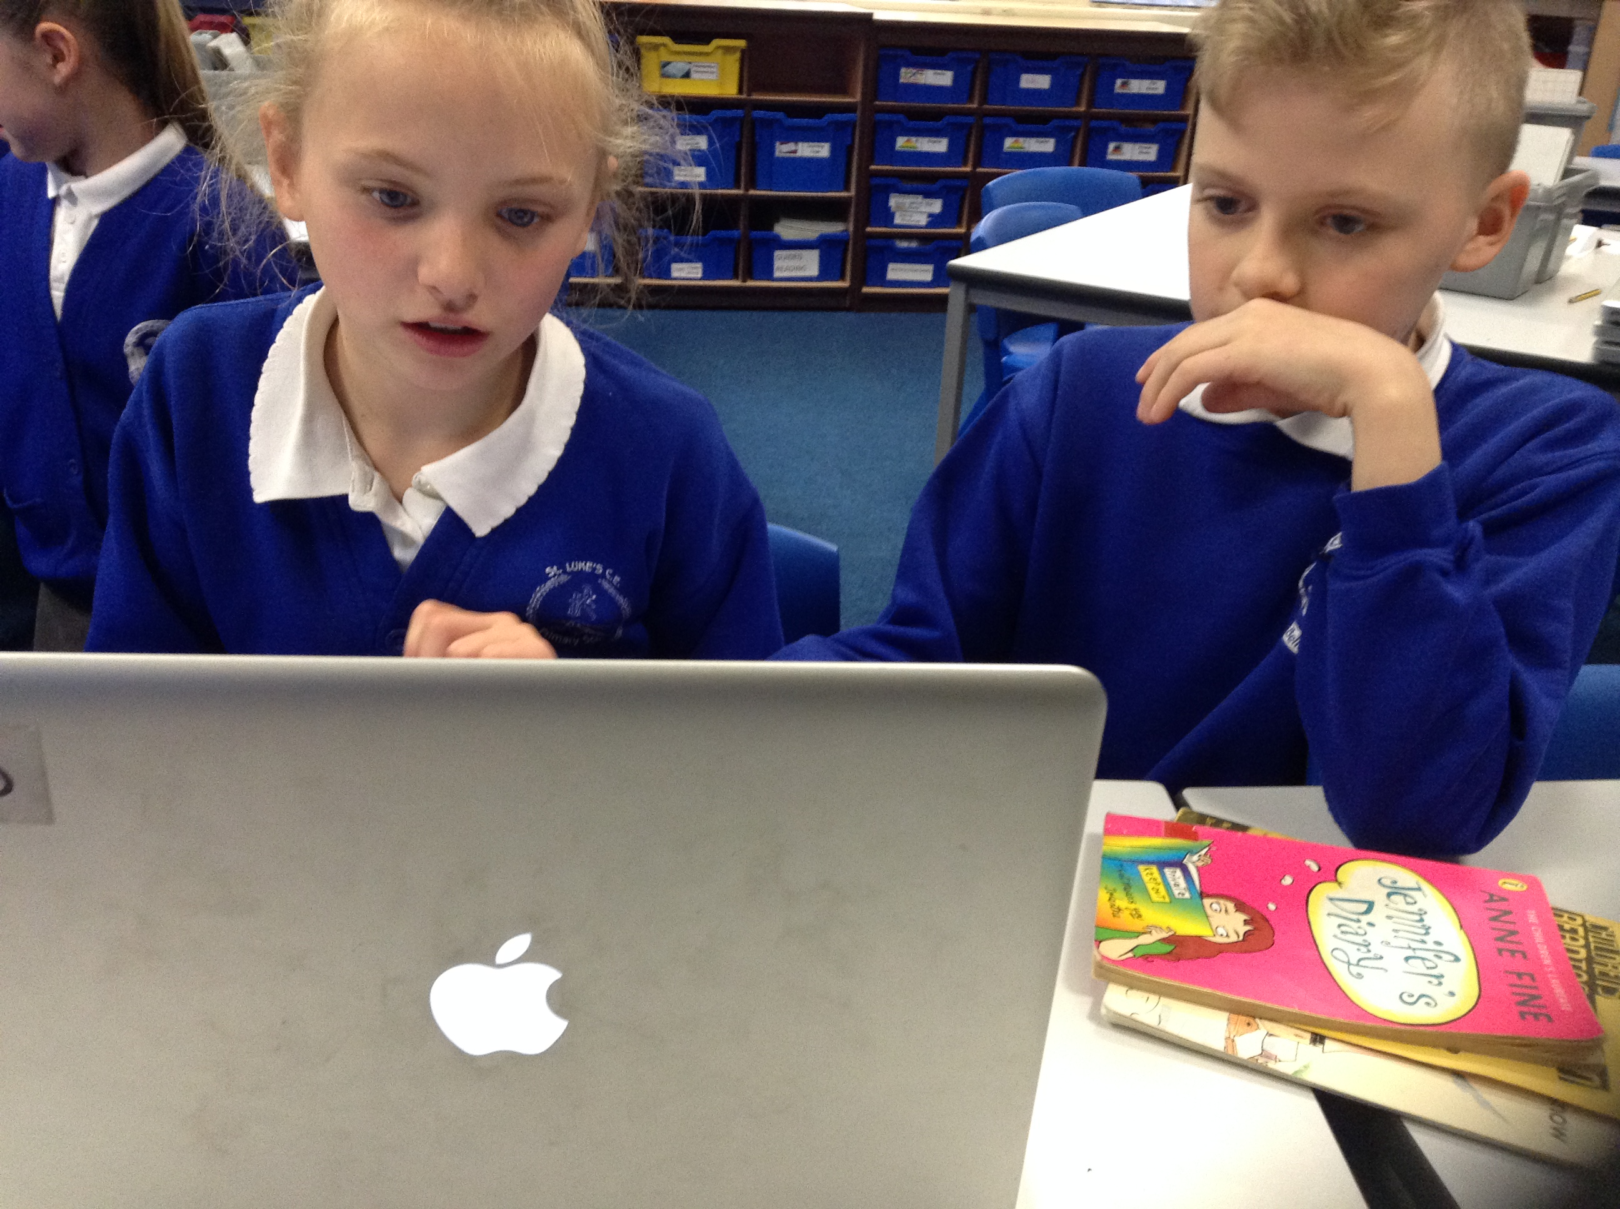
Year 5
In year 5 we helped on purple mash 2 calculate to work on a maths farmer project. We took Mrs upton’s planning and went through it then practised what we needed to do during digital leader club on a Wednesday. Then we taught the teaching assistants how to use the program and we created a powerpoint to teach the class. We were also asked to do a fun Christmas activity so we chose Christmas cards on paint a picture purple mash.

Slide 6
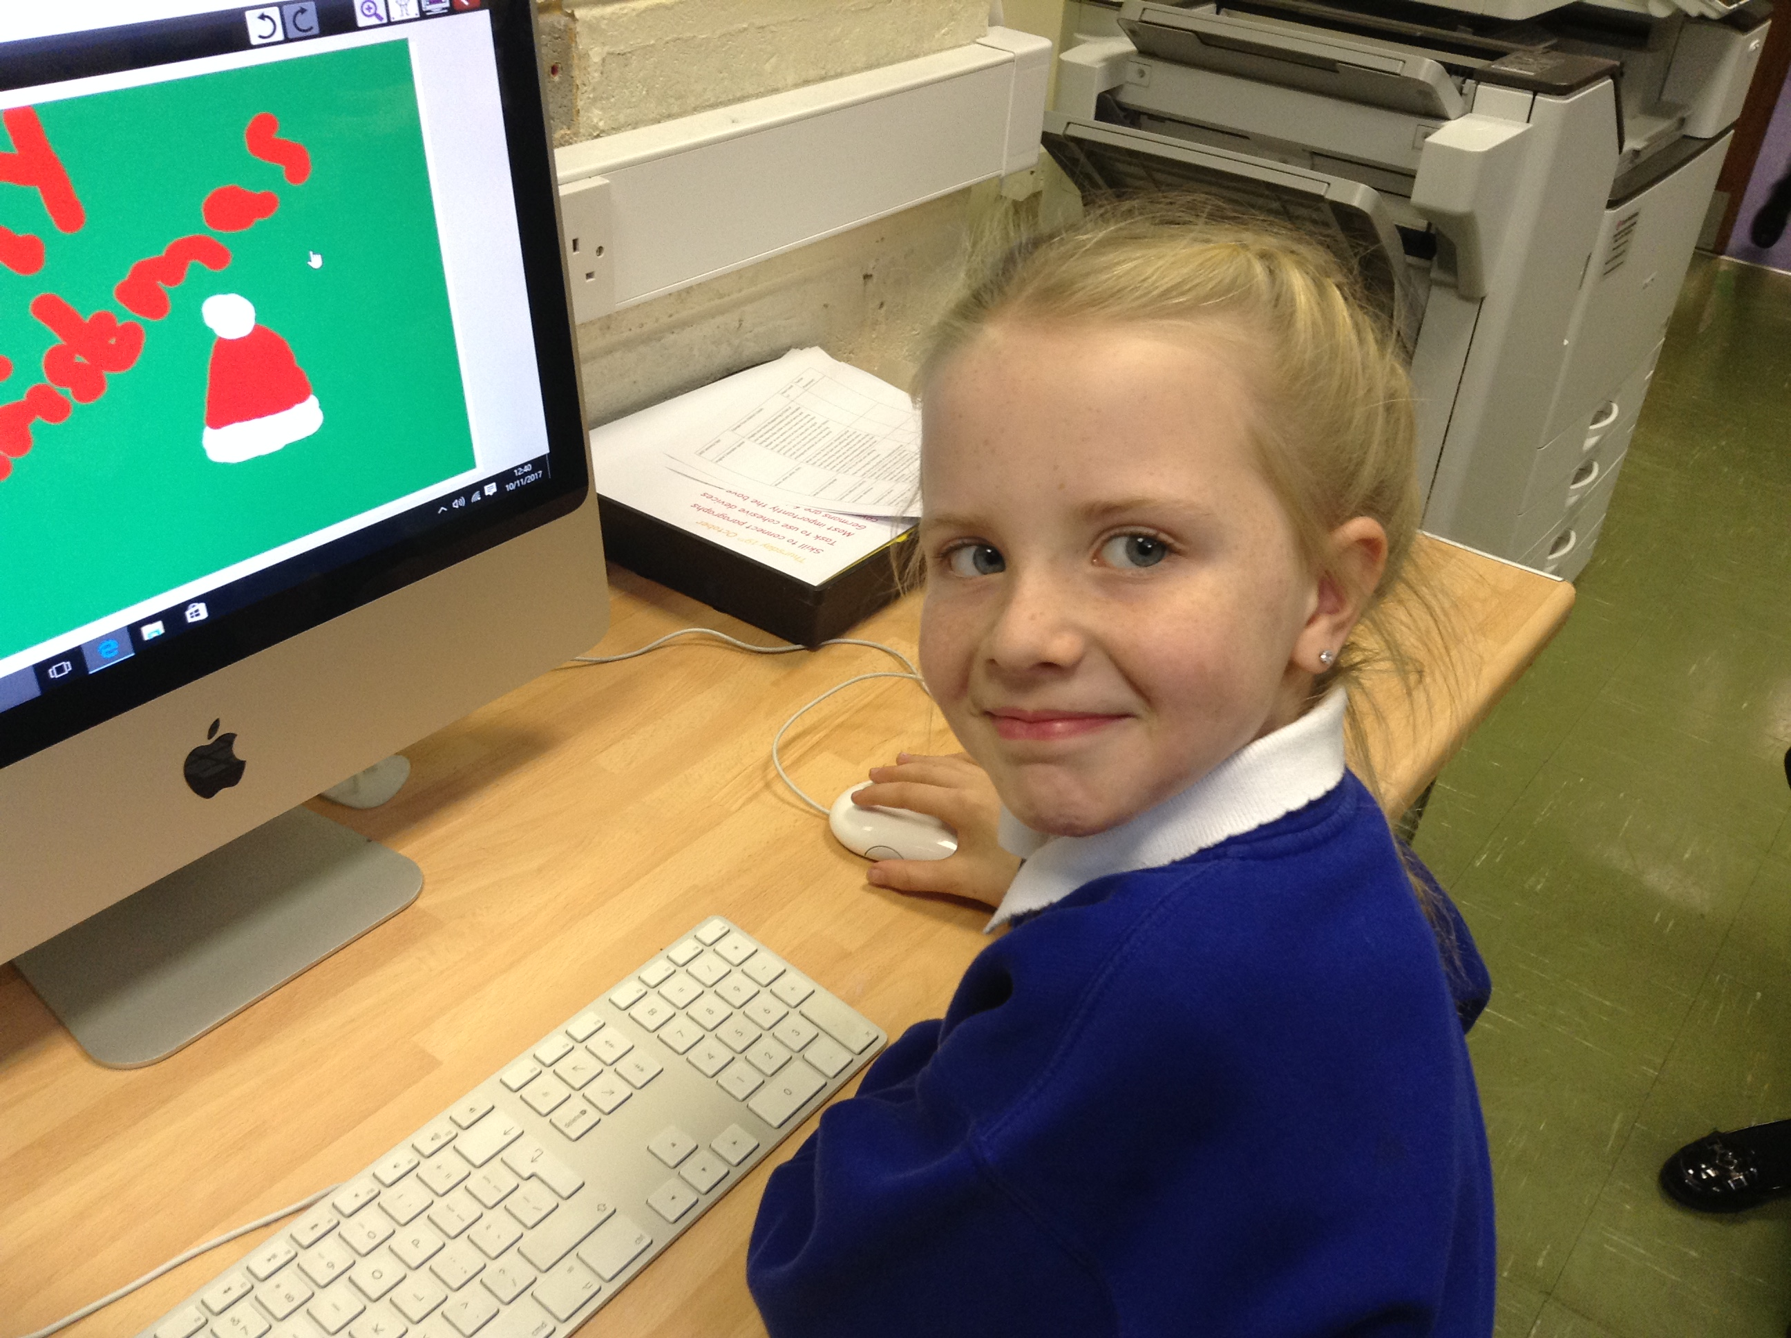
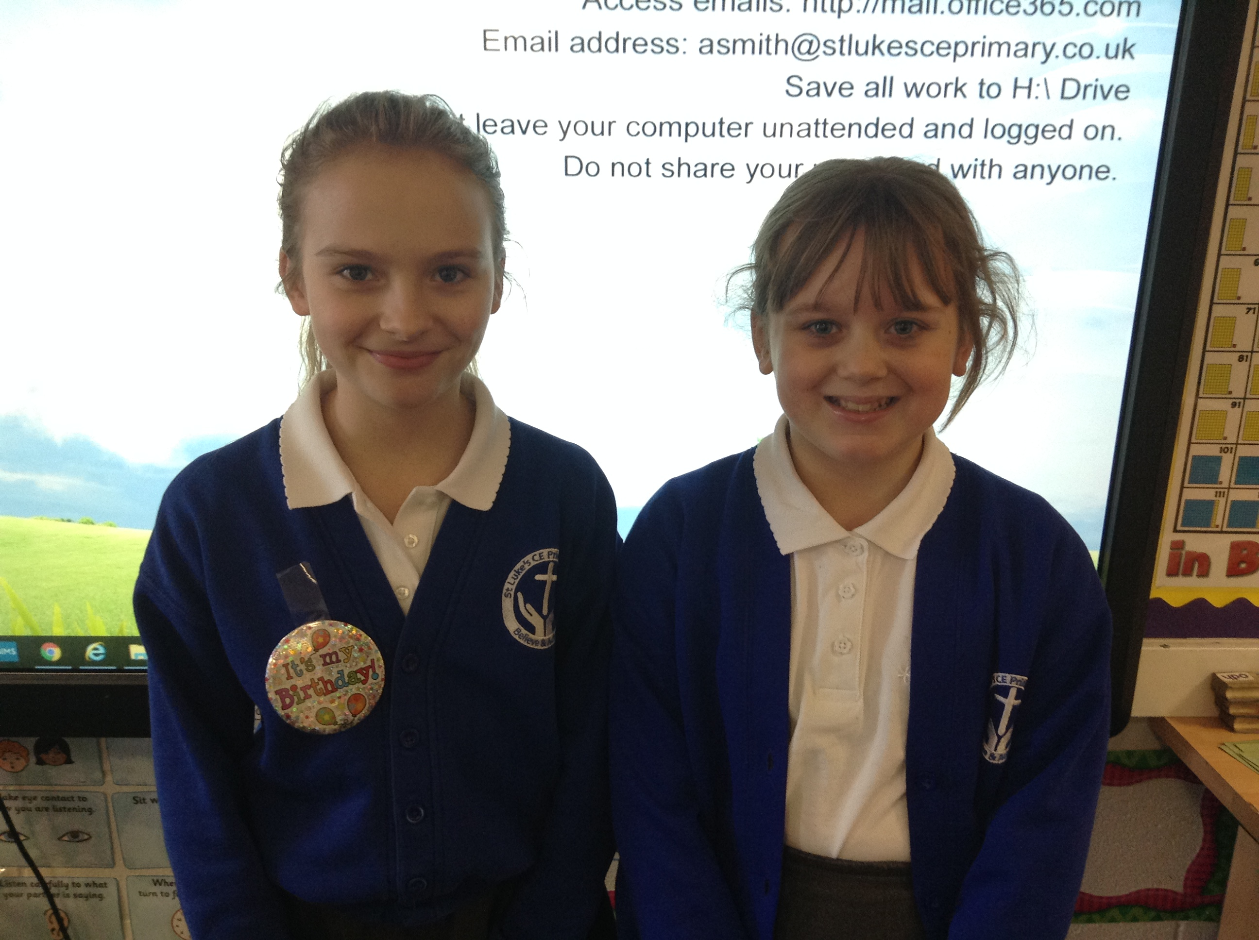
Sadly we are loosing one of our digital leaders next year as Ellie is moving school. Luckily though we have recruited two new digital leaders for next year.

